Slide 1

Plastic Packaging
Notes:
Source: https://www.unep.org/interactives/beat-plastic-pollution/#:~:text=Approximately%2036%20per%20cent%20of,landfills%20or%20as%20unregulated%20waste.

Slide 2
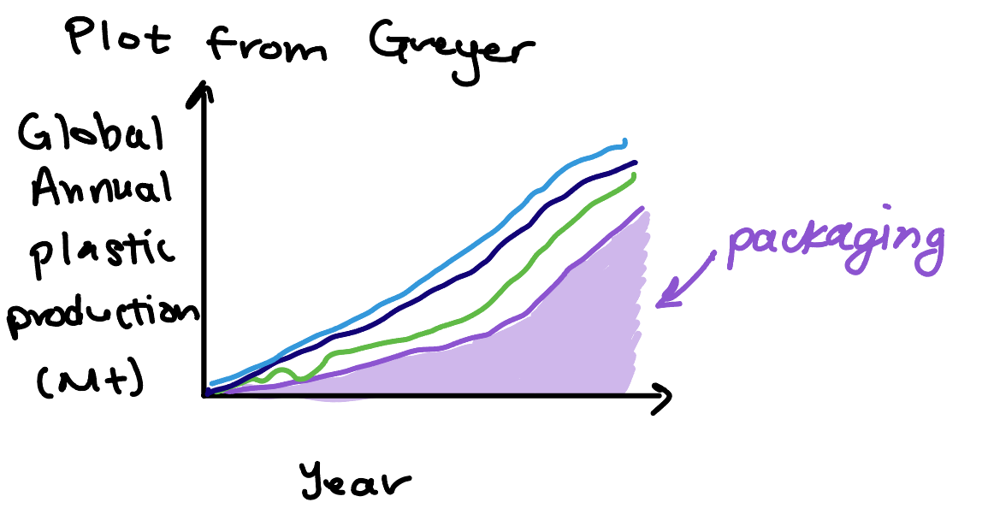
Packaging uses more plastic than any other sector
Geryer, R. Plastic Waste and Recycling, 2020.

Slide 3
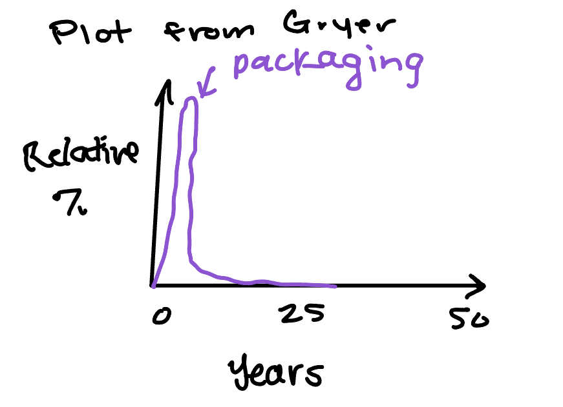
Most packaging is single use, so the average product lifetime is short
Geryer, R. Plastic Waste and Recycling, 2020.

Slide 4
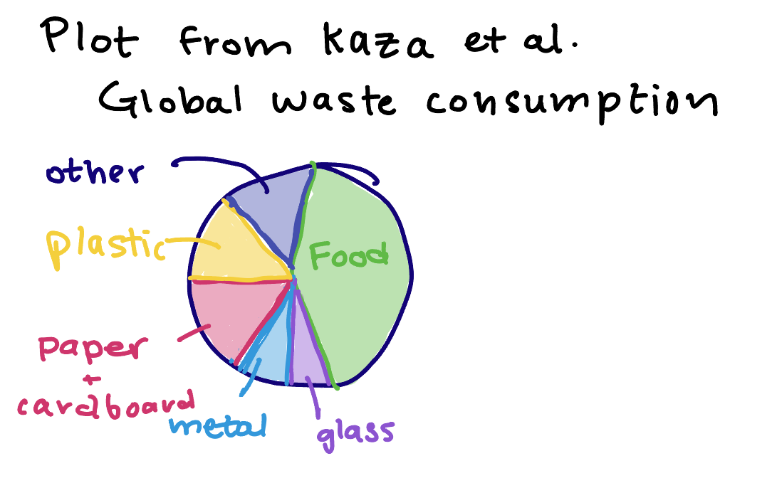
Food waste is a huge environmental and societal problem
Improved packaging could be part of the solution
Kaza, S. et al. What a Waste 2.0 : A Global Snapshot of Solid Waste Management to 2050. 2018.

Slide 5
Properties of food-specific packaging
Function
Property
Preservation
Containment
Protection
Permeability- protect against oxygen and moisture
Optical properties- clear, opaque (protect from light)
Form (processing)
Food-safe
Keep out bacteria
Hard or stiff layer to prevent damage
https://matmatch.com/learn/material/materials-used-in-food-packaging
Notes:
Source: https://matmatch.com/learn/material/materials-used-in-food-packaging

Slide 6

Common plastics used in food packaging
Polyethylene terephthalate (PET)
High-density polyethylene (HDPE)
Low-density polyethylene (LDPE)
Polypropylene (PP)
Polystyrene (PS)
Expanded polystyrene (PS)
Water bottles
Tray inserts
Squeeze bottles
Milk containers
Freezer bags
Ice cream containers
Bags
Trays
Film
Potato chip bags Microwave-safe dishes
Bottle caps
Cutlery
Plates
Cups
Hot drink cups
Protective packaging
https://www.unep.org/interactives/beat-plastic-pollution/#:~:text=Approximately%2036%20per%20cent%20of,landfills%20or%20as%20unregulated%20waste.

Slide 7

What can be done to reduce packaging waste?
Bans
Fund innovation in reusable plastics
Incentivize circular economies
Invest in higher quality, reusable products
Reuse bags, refill containers, choose food with minimal packaging
Pressure local authorities to implement regulations
Government/Regulations
Individual
Innovate business model to favor reusable plastic products
Provide reliable and transparent sustainability information
Increase recycled content in new products
Plastic Industry
https://www.unep.org/interactives/beat-plastic-pollution/#:~:text=Approximately%2036%20per%20cent%20of,landfills%20or%20as%20unregulated%20waste.

